Slide 1
It’s a Plastic World

Slide 2
Alejandro Durán
From the series “Washed up”
Washed Up is an environmental installation and photography project that transforms the international debris washing up on Mexico's Caribbean coast into aesthetic yet disquieting works.
Over the course of this project Durán has identified plastic waste from fifty-eight nations and territories on six continents that have washed ashore along the coast of Sian Ka'an, Mexico's largest federally protected reserve and an UNESCO World Heritage site. He uses this international debris to create color-based, site-specific sculptures that conflate the hand of man and nature. At times he distributes the objects the way the waves would; at other times, the plastic mimics algae, roots, rivers, or fruit, reflecting the infiltration of plastics into the natural environment.
More than creating a surreal or fantastical landscape, these installations mirror the reality of our current environmental predicament. The resulting photo series depicts a new form of colonization by consumerism, where even undeveloped land is not safe from the far-reaching impact of our culture of disposable products. The alchemy of Washed Up lies not only in transforming a trashed landscape, but in the project’s potential to raise awareness and change our relationship to consumption and waste.

Slide 3
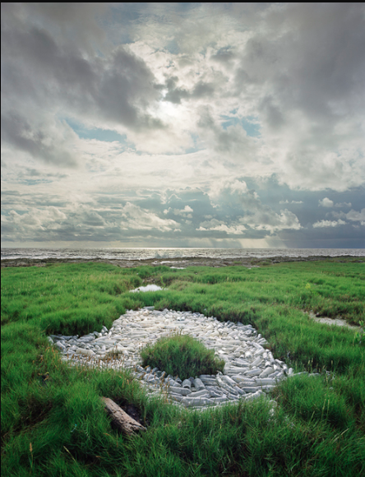

Slide 4
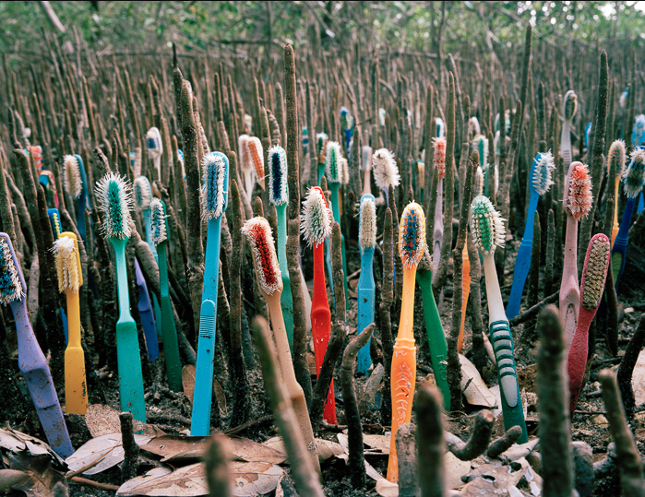

Slide 5
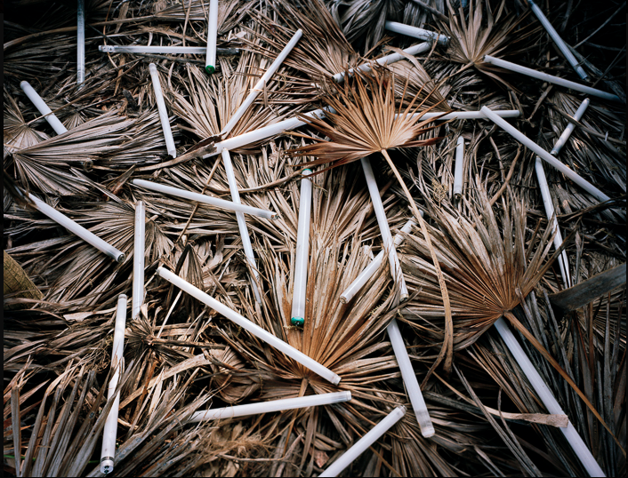

Slide 6
MANDY BARKER
Mandy Barker is an international award-winning photographer whose work involving marine plastic debris over the past 10 years has received global recognition. Working with scientists she aims to raise awareness about plastic pollution in the world's oceans whilst highlighting the harmful affect on marine life and ultimately ourselves.

Slide 7
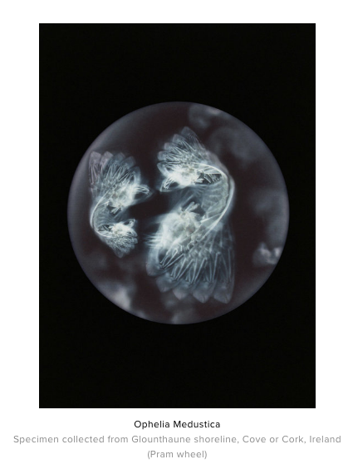

Slide 8
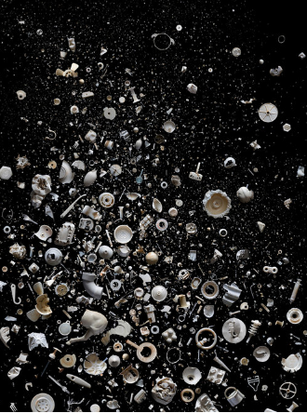

Slide 9
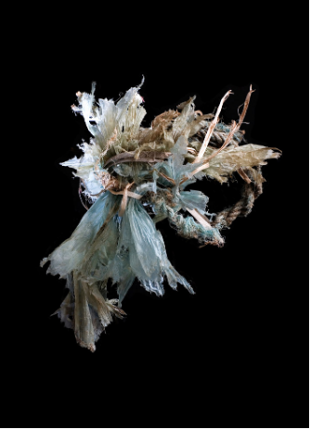

Slide 10
Alison Postma
My work is currently exploring getting to know objects. Through arranging and photographing still lifes, performing small gestures captured with video, or modifying found objects, I learn about objects with my hands and body.

Slide 11
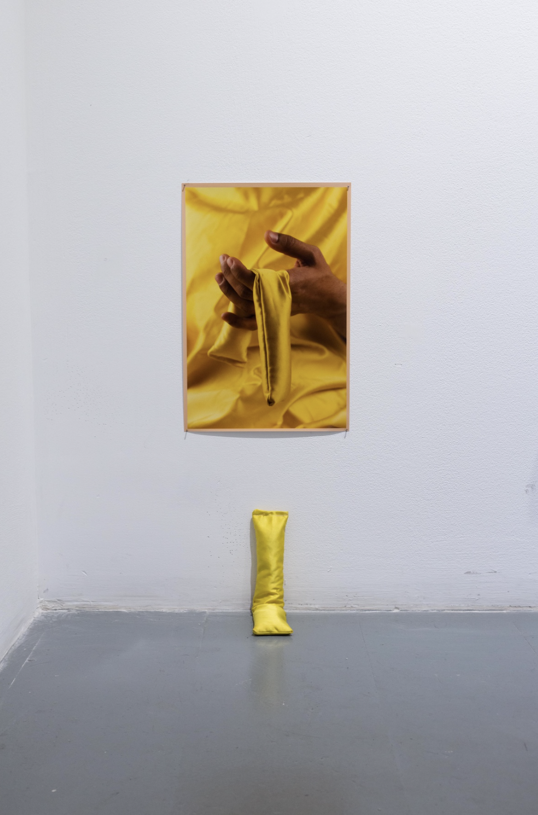

Slide 12
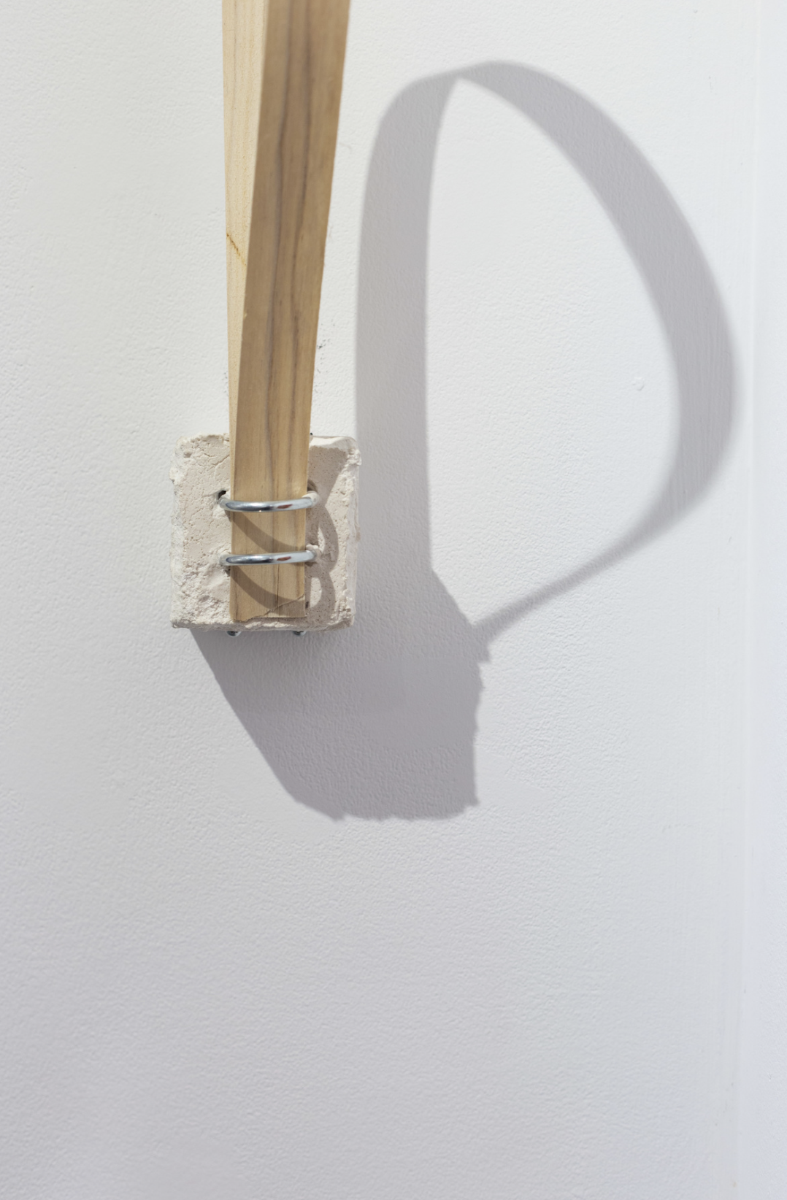

Slide 13
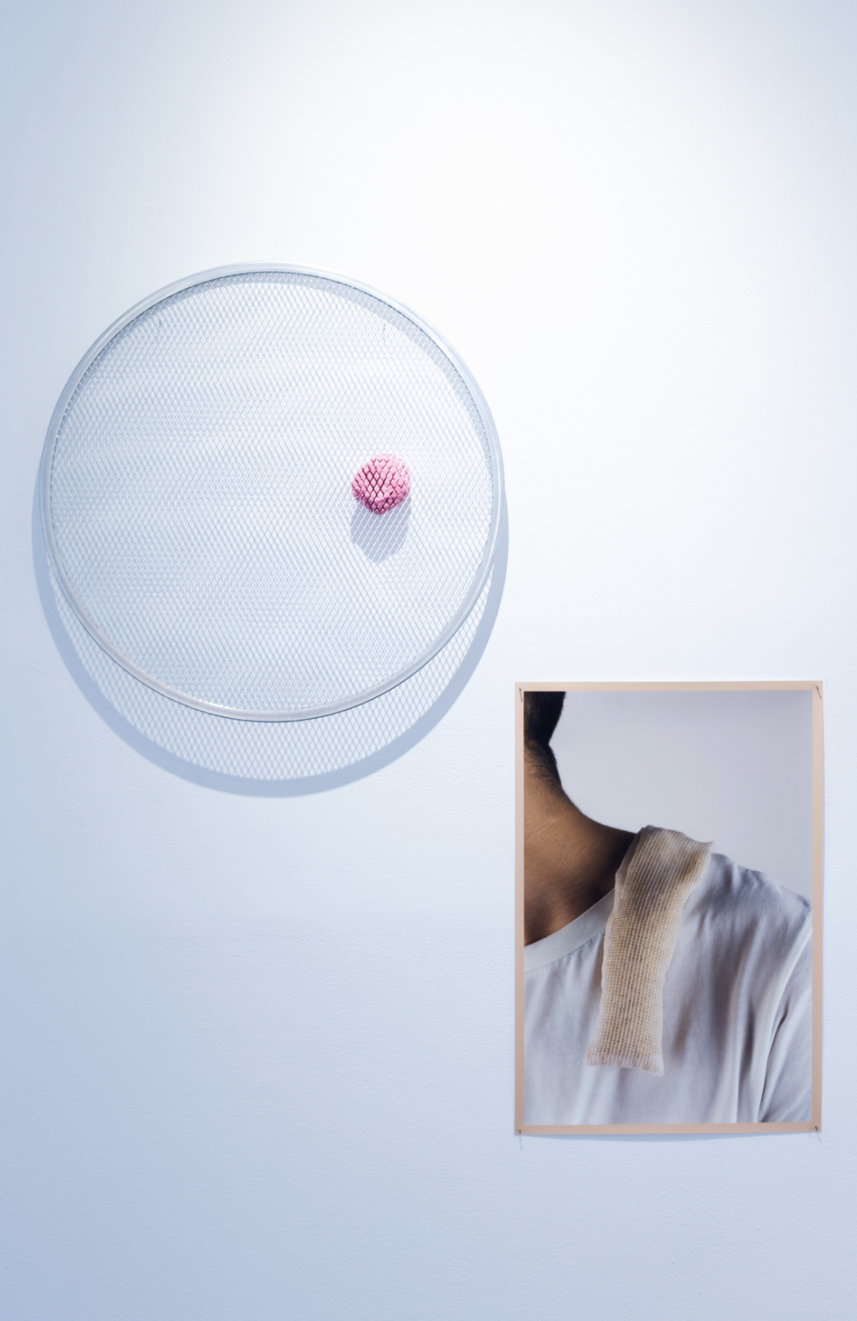

Slide 14
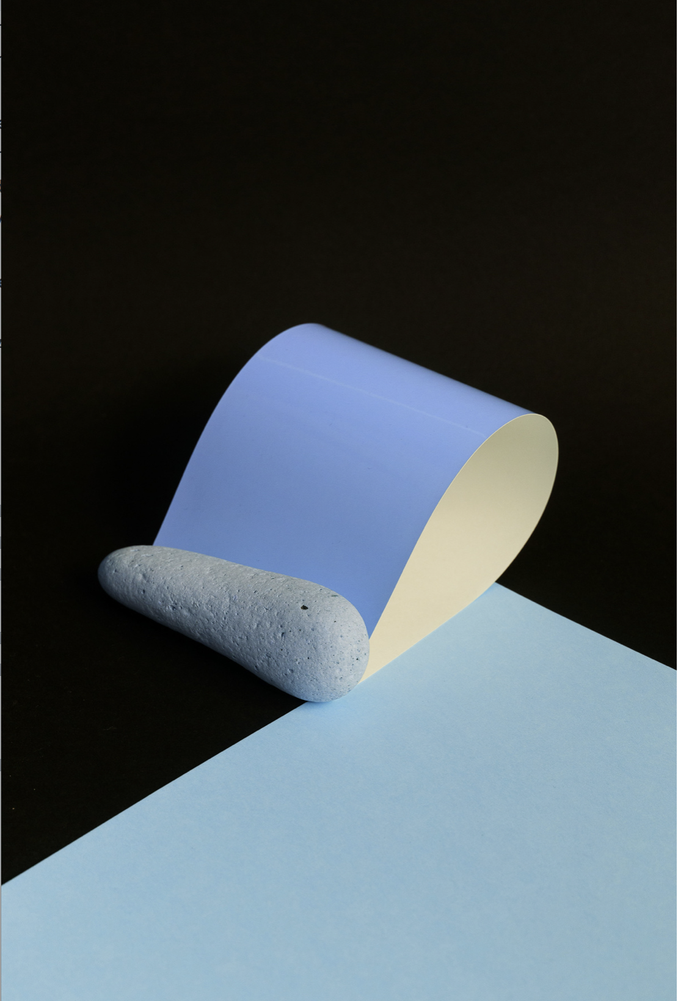

Slide 15
Fabrice Monteiro
From the series “The Prophecy”
Senegalese photographer Fabrice Monteiro believes we are already living in a dystopian world, on an earth that humans have made sick.
His series The Prophecy shines a light on environmental degradation in West Africa. While the photographs have been called dystopian, he’s quick to point out the scenery is all real. “I’m not so much interested in the future because I think the reality right now, the present, we have enough to deal with.” he said. “If you take the characters out, you can take your camera and find these places in Senegal.”

Slide 16
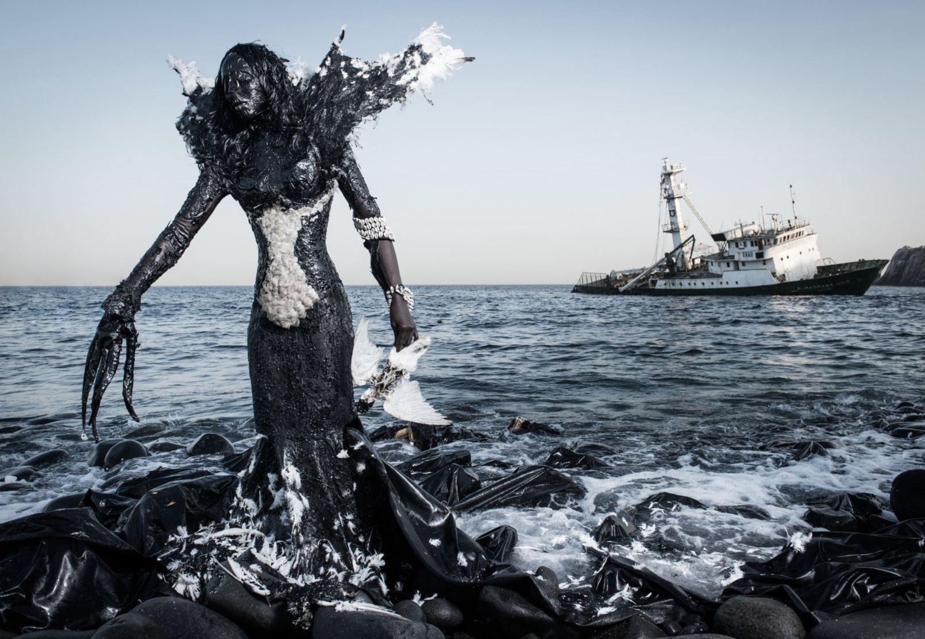

Slide 17
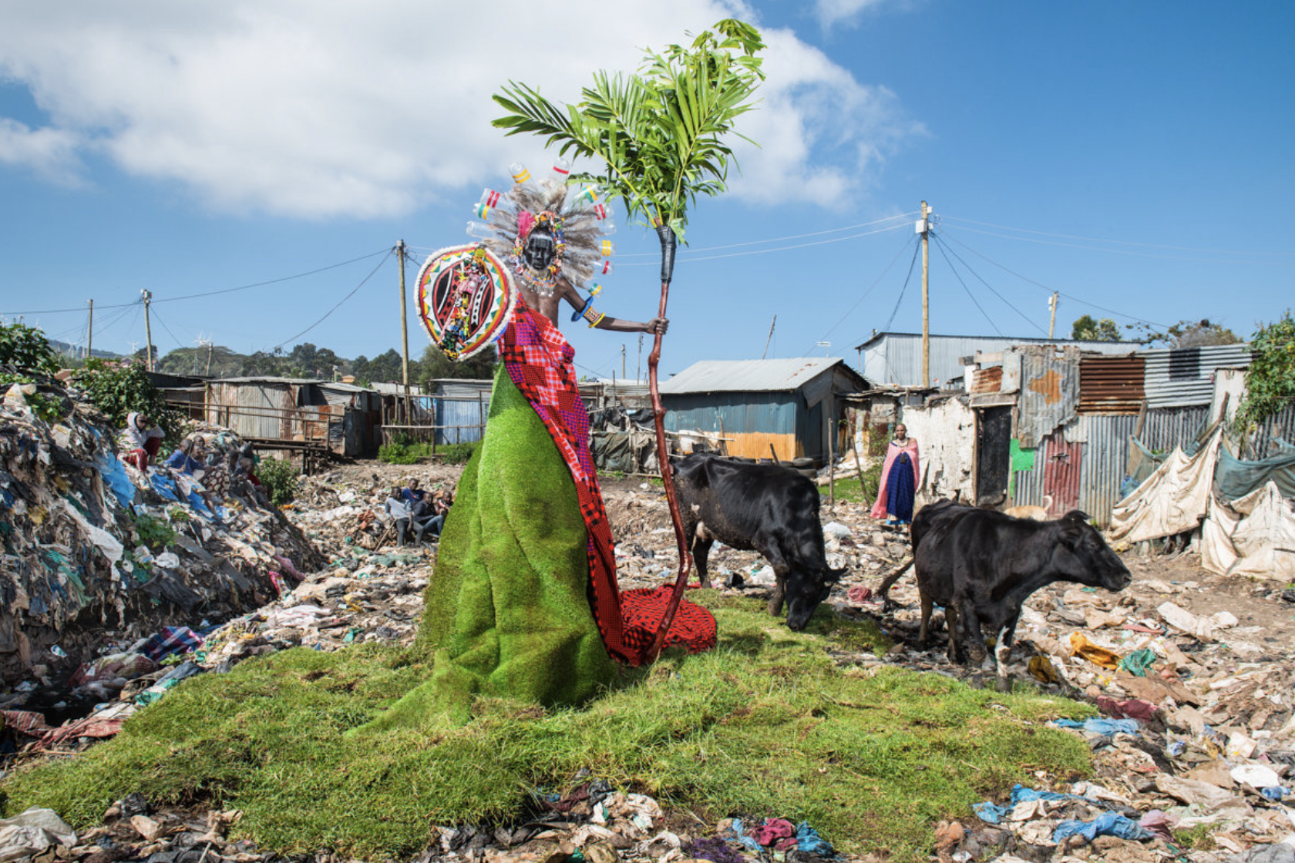

Slide 18
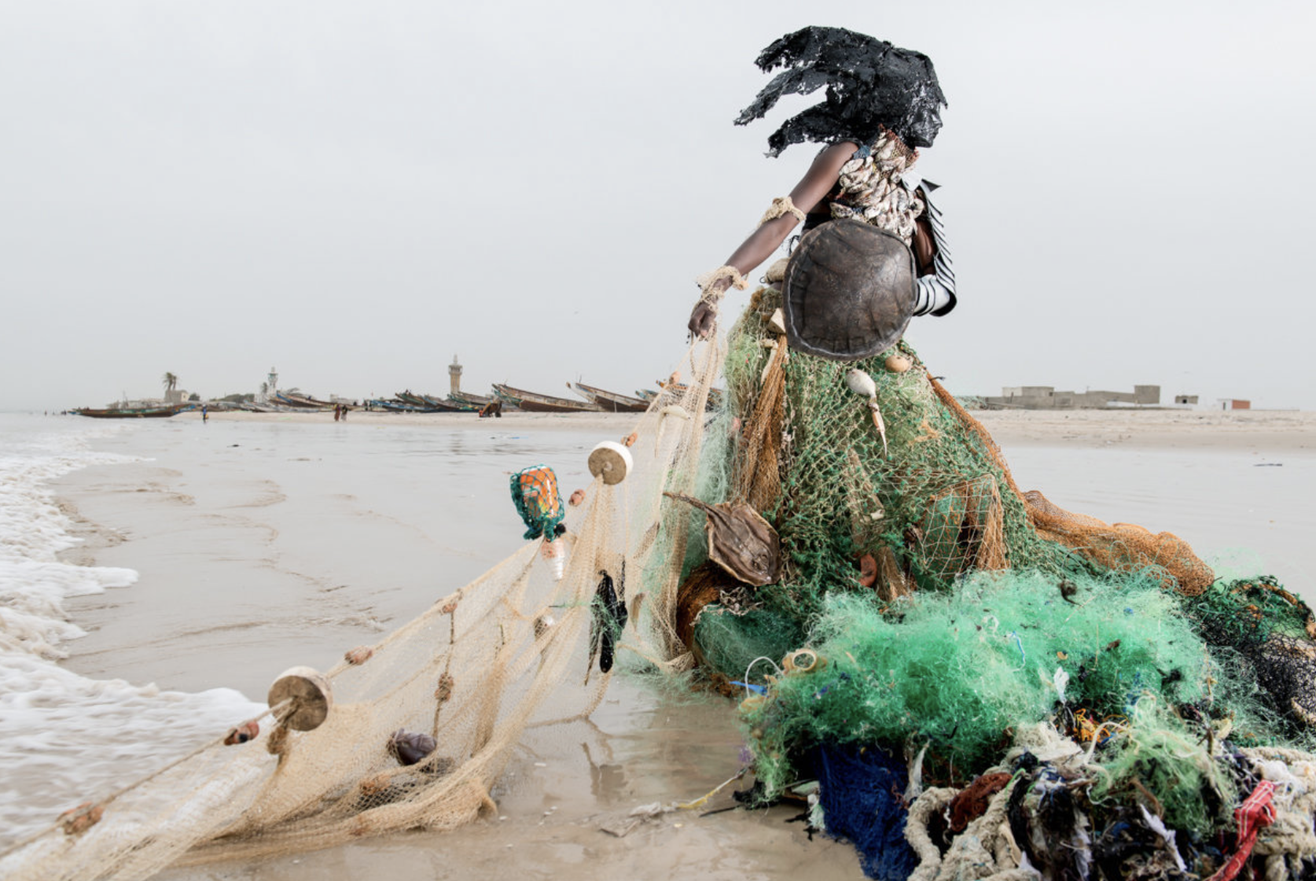

Slide 19
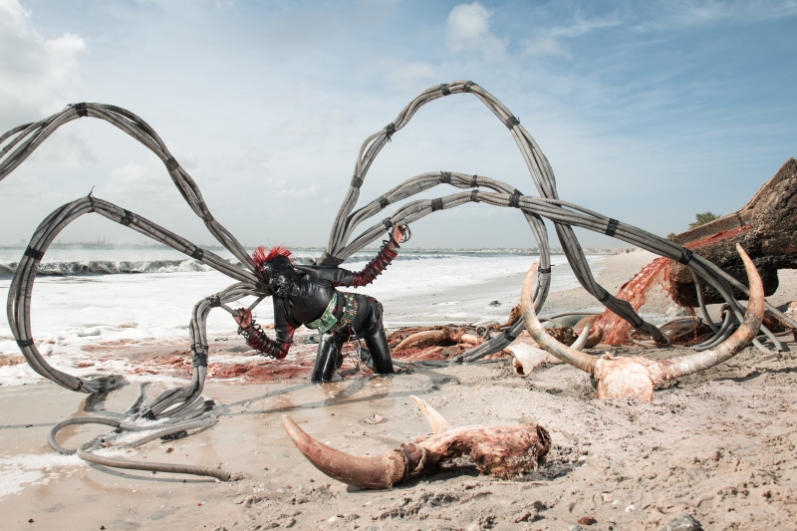

Slide 20
Fashion from Brother Veilles

Slide 21
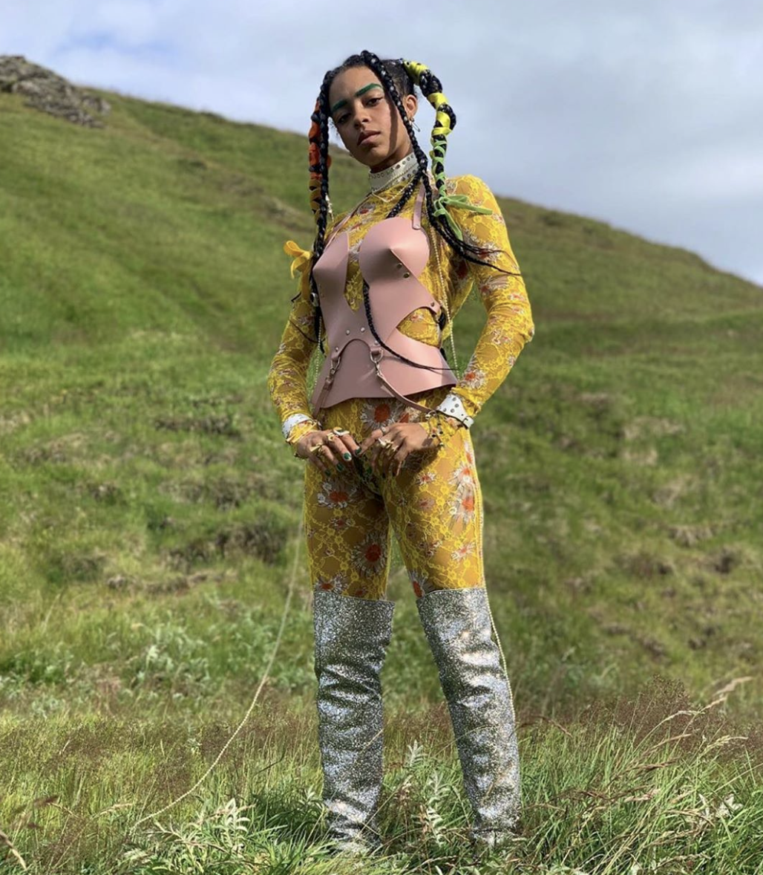

Slide 22


Slide 23


Slide 24
Gary Emrich
from the series “All Consumed”
ALL CONSUMED is a series of landscape photographs fabricated with advertising imagery of lush greenery, blue skies and snow-capped mountains from the plastic wrappers on multipacks of bottled water. Addressing how the bottled water industry uses marketing tools to drive Americans to consume 50 billion bottles of water a year at 1000 times the cost of tap water, this project combines a marketing image of nature's purity with plastic waste products to call out the hypocrisy of consumer culture.

Slide 25
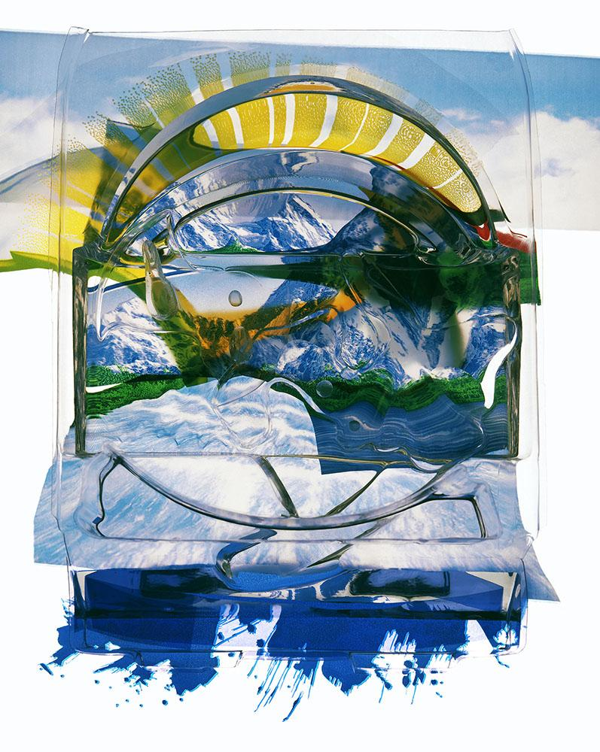

Slide 26
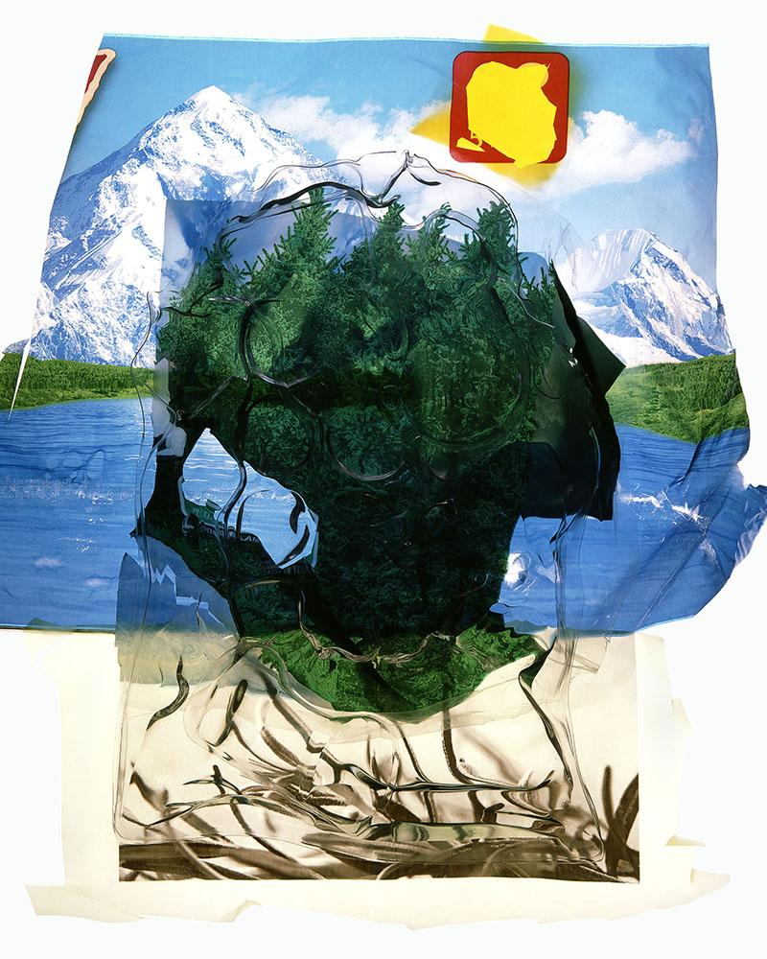

Slide 27
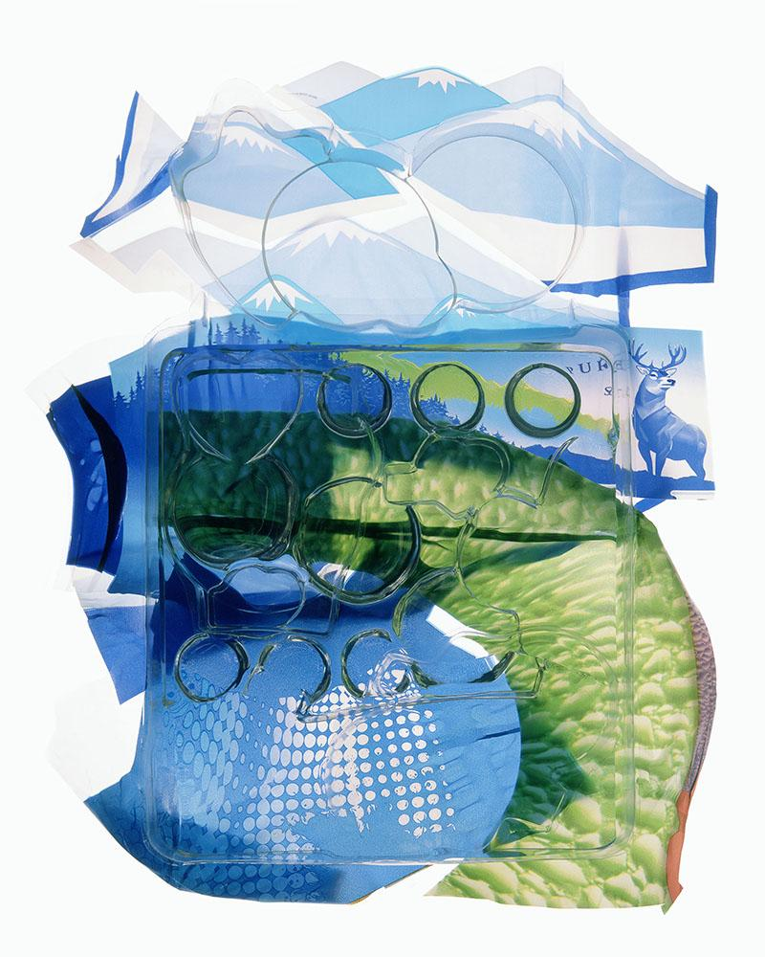

Slide 28
Gregg Segal
From the series “7 Days of Garbage”
Ever since I was a kid, I’ve wondered about garbage - where does it go and what happens when we run out of places to put it? The average American generates 29 pounds of garbage a week. As a nation, that amounts to about 9 billion pounds per week! I’m concerned not only by how much we throw away, but by how blithe we are to the problem.
With 7 Days of Garbage, I call attention to the problem of waste by personalizing it. I asked family, friends, neighbors and other acquaintances to save their trash and recyclables for a week and then lie down and be photographed in it..

Slide 29
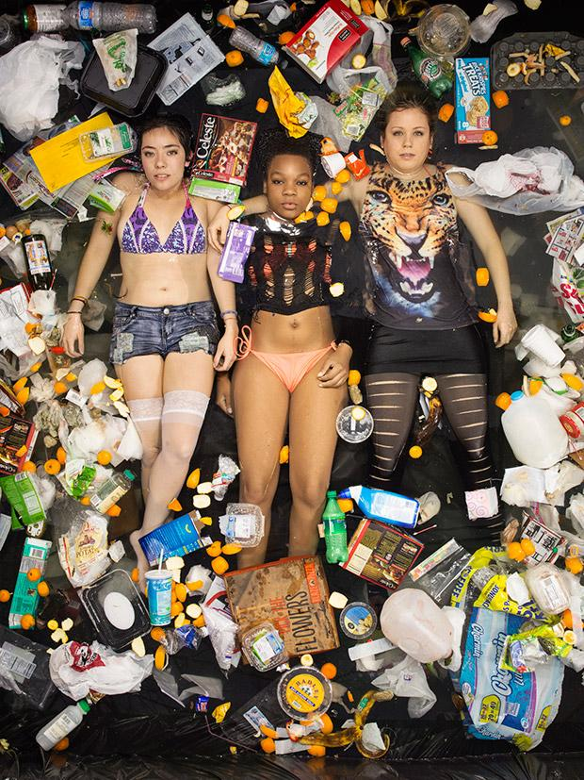

Slide 30
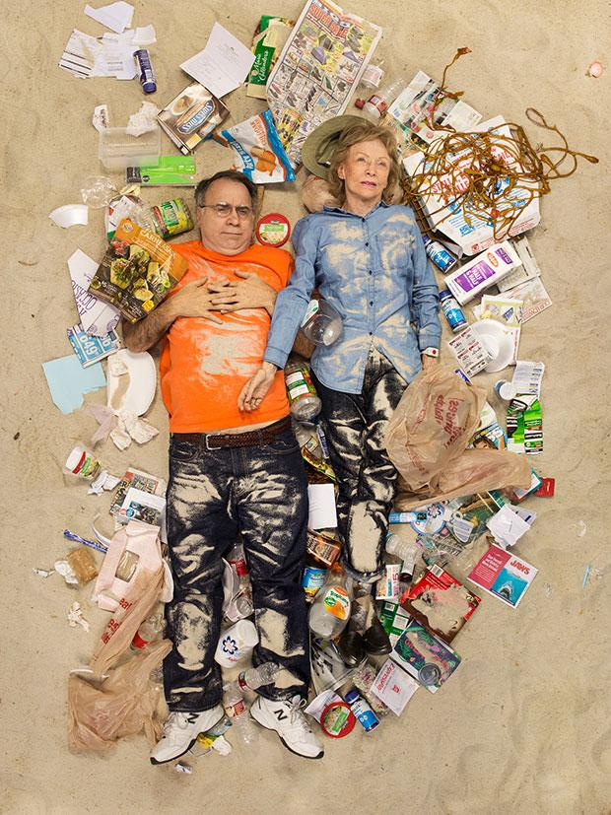

Slide 31
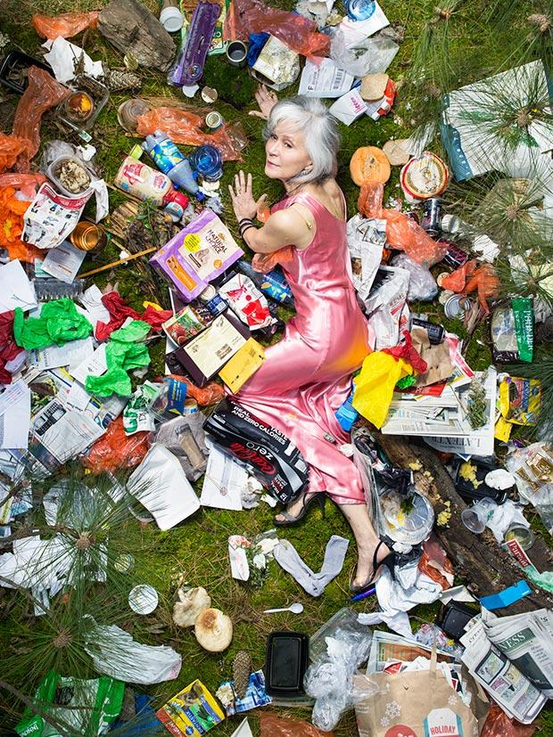

Slide 32
Jimmy Limit
From the exhibition “Show Room”
Evolving out of an interest in stock photography and an affinity for the aesthetic of the ULINE Catalogue, Jimmy Limit’s recent exhibition “Show Room” presented a collection of photographs and sculptures that explored relationships between image, object and consumption. Through an exploration of photography as both a tool to sell commodities and as a commodity in its own right, “Show Room” addressed the multilayered relationship between photography and commerce.

Slide 33
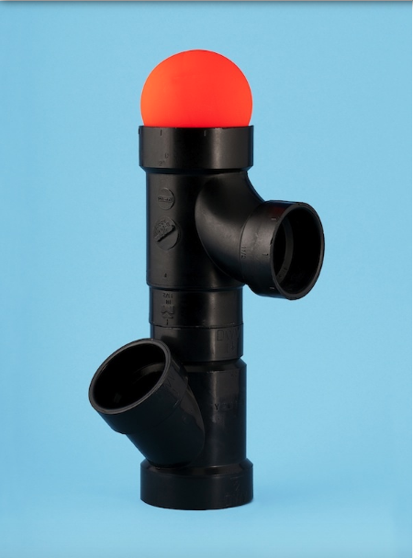

Slide 34
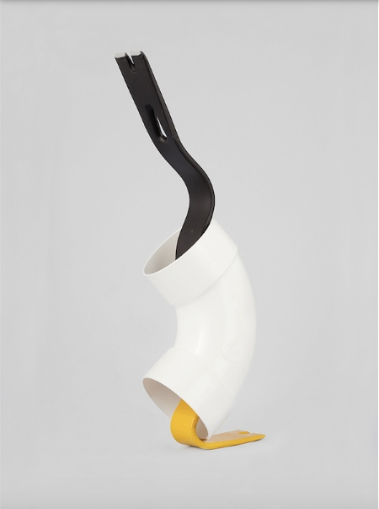

Slide 35
Mandy Barker
"The aim of my work is to engage with and stimulate an emotional response in the viewer by combining a contradiction between initial aesthetic attraction along with the subsequent message of awareness. The research process is a vital part of my development as the images I make are based on scientific fact, essential to the integrity of my work. The impact of marine plastic is an area I have documented for more than 10 years and am committed to pursuing through visual interpretation, and in collaboration with science I hope it will ultimately lead to positive action in tackling this increasing environmental problem, which is currently of global concern".

Slide 36
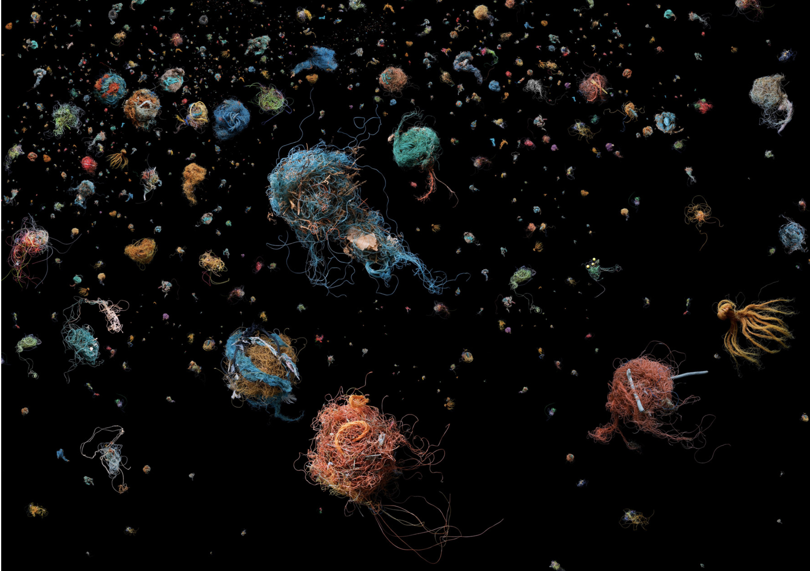

Slide 37
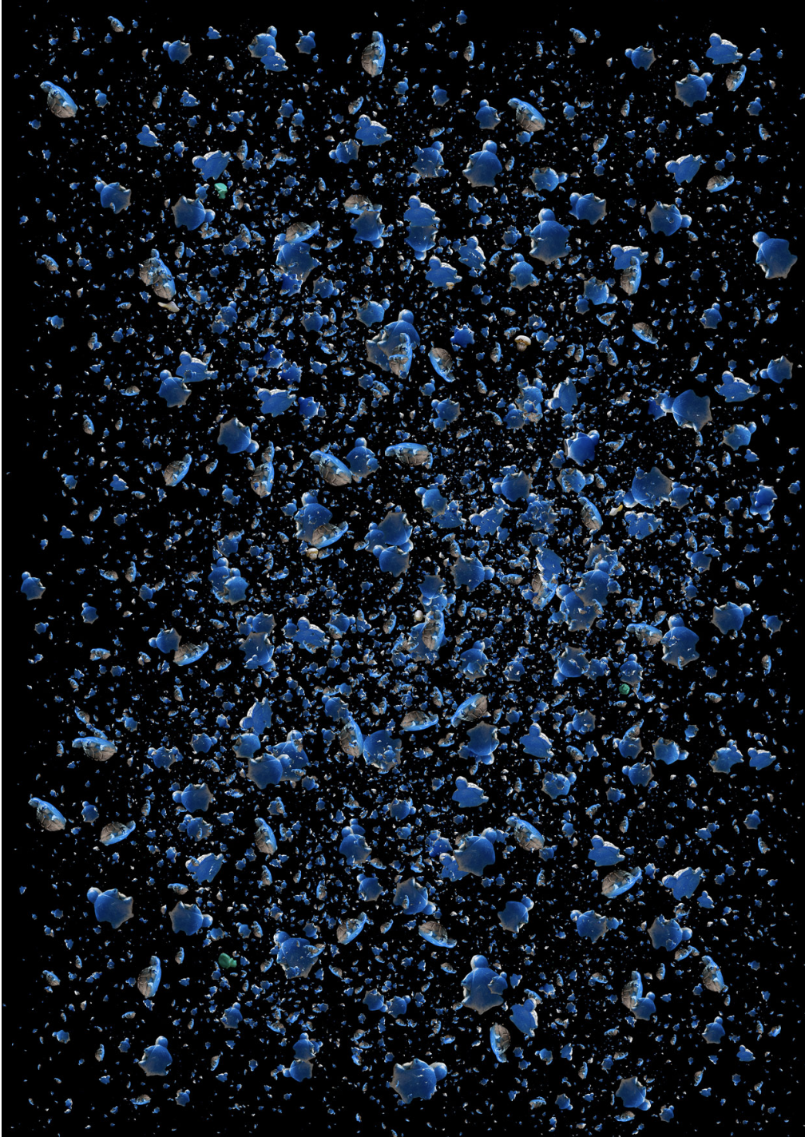

Slide 38
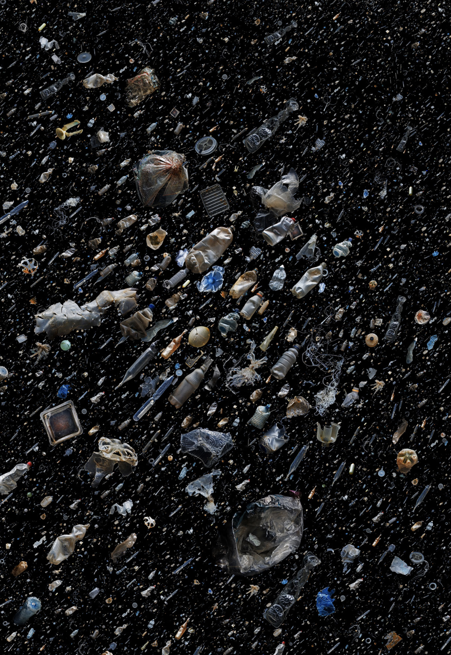

Slide 39
Chris Jordan
From his series “Midway”
On Midway Atoll, a remote cluster of islands more than 2000 miles from the nearest continent, the detritus of our mass consumption surfaces in an astonishing place: inside the stomachs of thousands of dead baby albatrosses. The nesting chicks are fed lethal quantities of plastic by their parents, who mistake the floating trash for food as they forage over the vast polluted Pacific Ocean.
For me, kneeling over their carcasses is like looking into a macabre mirror. These birds reflect back an appallingly emblematic result of the collective trance of our consumerism and runaway industrial growth. Like the albatross, we first-world humans find ourselves lacking the ability to discern anymore what is nourishing from what is toxic to our lives and our spirits. Choked to death on our waste, the mythical albatross calls upon us to recognize that our greatest challenge lies not out there, but in here.

Slide 40
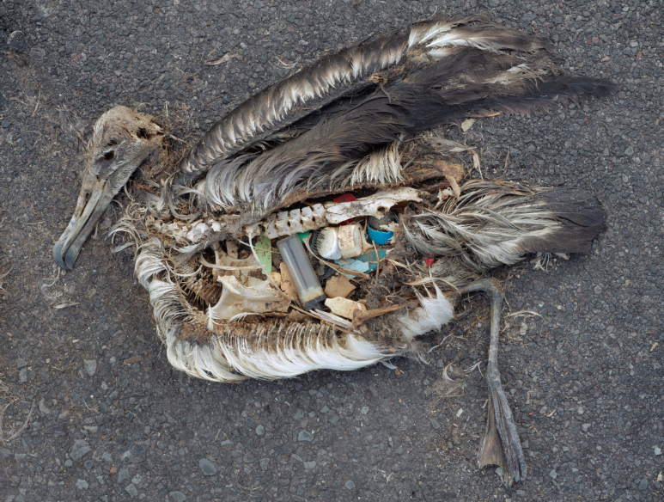

Slide 41
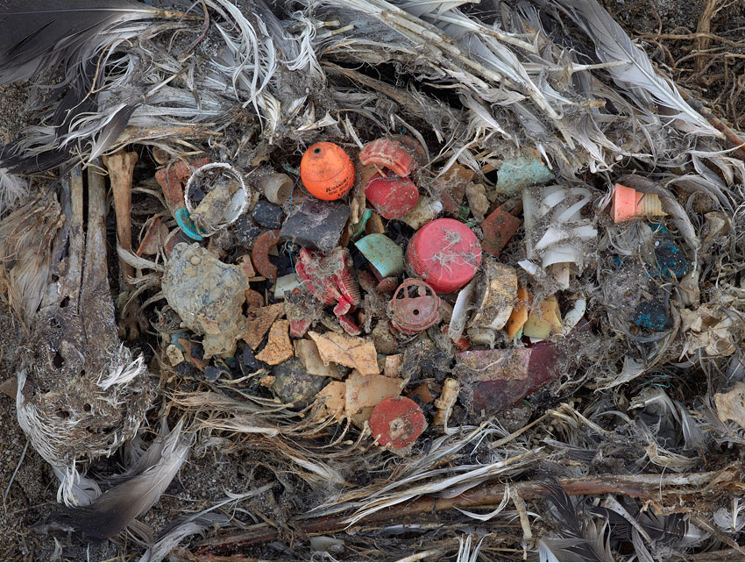

Slide 42
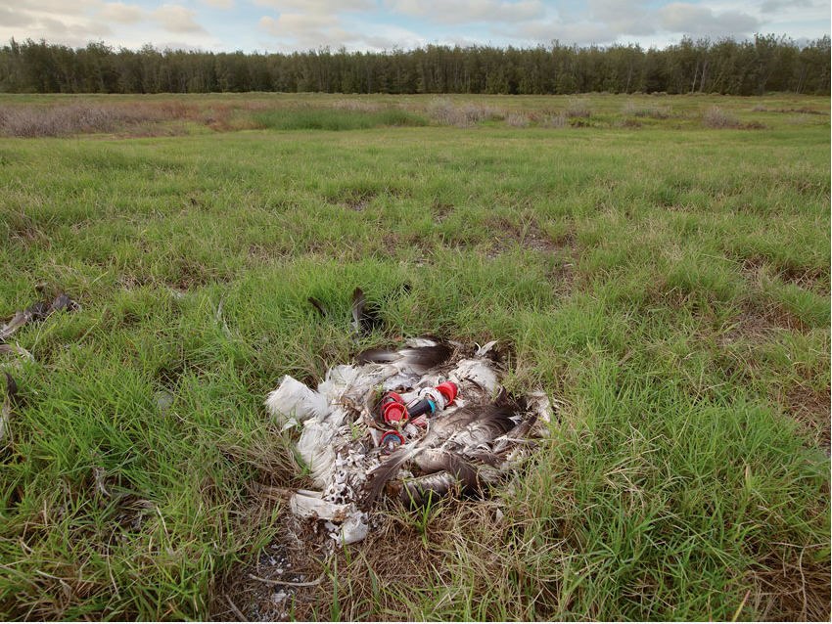

Slide 43
Chris Jordan
From his series “Intolerable Beauty”
Exploring around our country's shipping ports and industrial yards, where the accumulated detritus of our consumption is exposed to view like eroded layers in the Grand Canyon, I find evidence of a slow-motion apocalypse in progress. I am appalled by these scenes, and yet also drawn into them with awe and fascination. The immense scale of our consumption can appear desolate, macabre, oddly comical and ironic, and even darkly beautiful; for me its consistent feature is a staggering complexity.
The pervasiveness of our consumerism holds a seductive kind of mob mentality. Collectively we are committing a vast and unsustainable act of taking, but we each are anonymous and no one is in charge or accountable for the consequences. I fear that in this process we are doing irreparable harm to our planet and to our individual spirits.
As an American consumer myself, I am in no position to finger wag; but I do know that when we reflect on a difficult question in the absence of an answer, our attention can turn inward, and in that space may exist the possibility of some evolution of thought or action. So my hope is that these photographs can serve as portals to a kind of cultural self-inquiry. It may not be the most comfortable terrain, but I have heard it said that in risking self-awareness, at least we know that we are awake.

Slide 44
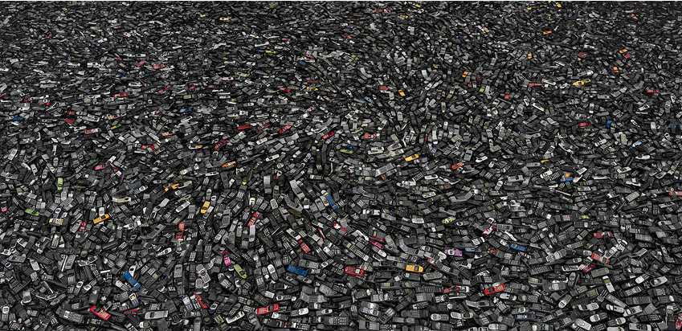

Slide 45
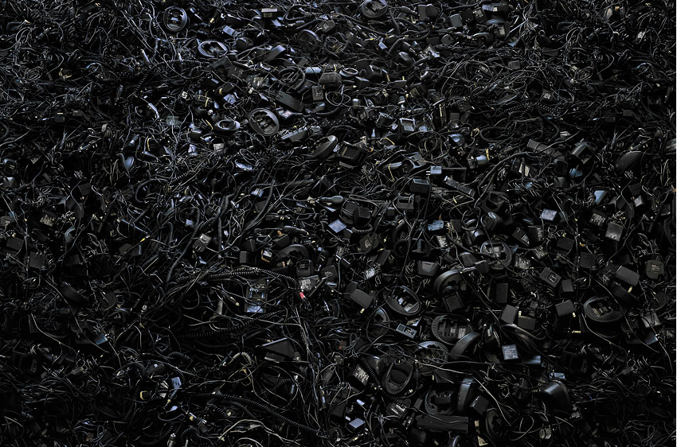

Slide 46
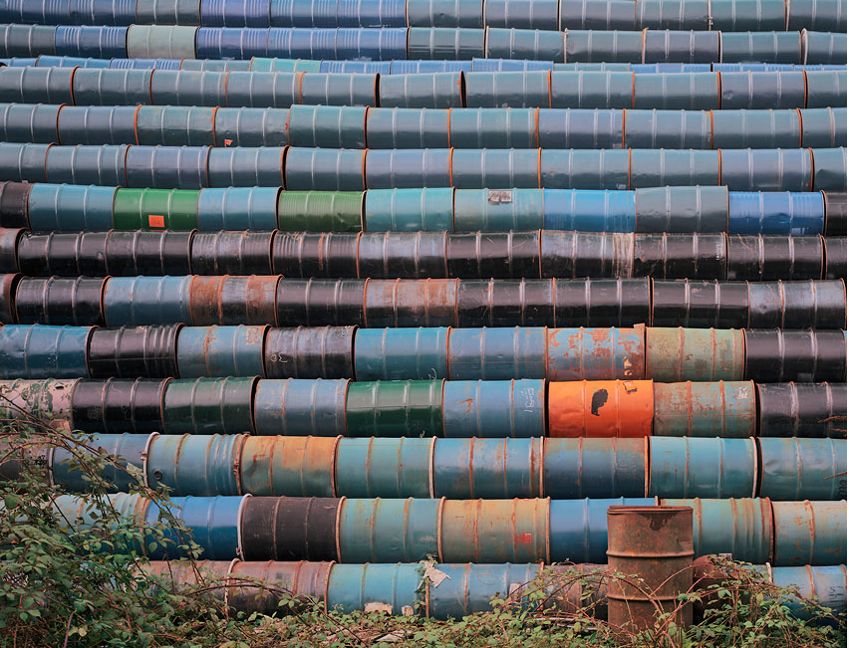

Slide 47
Paul Bulteel
From his series “Cycle and Recycle”
Society’s leftovers—collected and reclaimed
Waste: like the air we breathe, it is part of life. When badly managed, it destroys habitats on land, pollutes the air, and befouls our rivers and oceans. For human populations this translates into major health issues. Avoiding excess consumption and recycling waste are therefore crucial. But what does recycling really mean? Although the term is familiar, hardly anyone can form a mental picture of what recycling actually entails. Belgian photographer Paul Bulteel takes on this task in a series of striking and highly illuminating photographs of what happens when our discarded paper, metal, glass, plastic, appliances, clothing and countless other industrial byproducts and leftovers are broken down and transformed into new materials. Visually fascinating and well documented, these images give us food for thought.

Slide 48
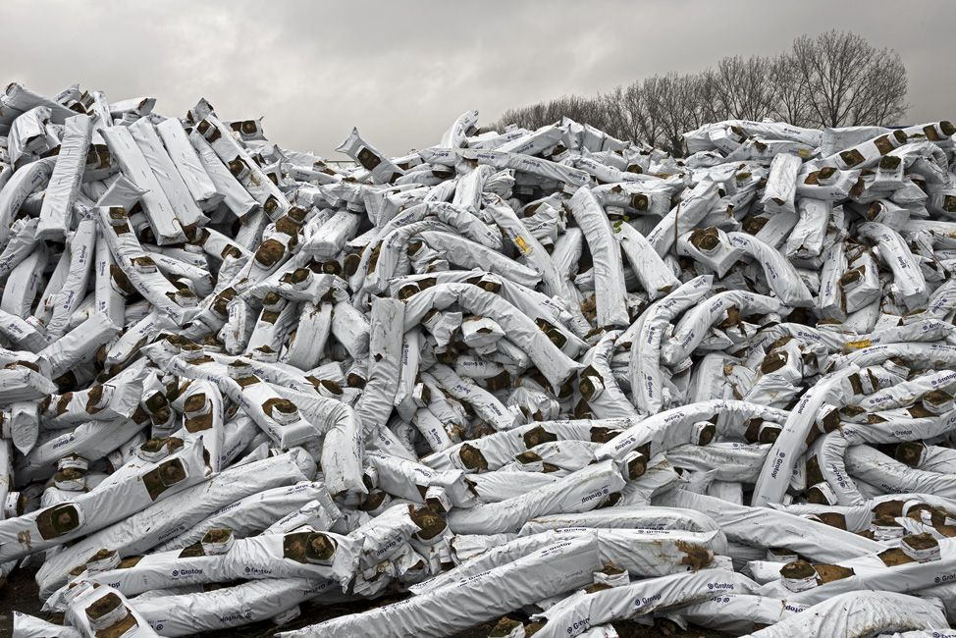

Slide 49
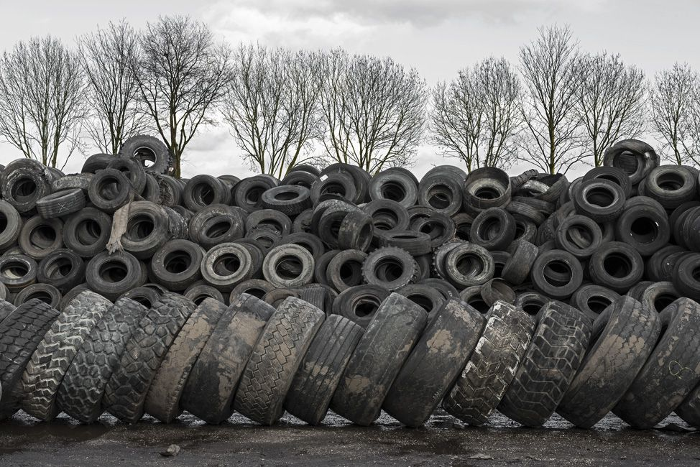

Slide 50
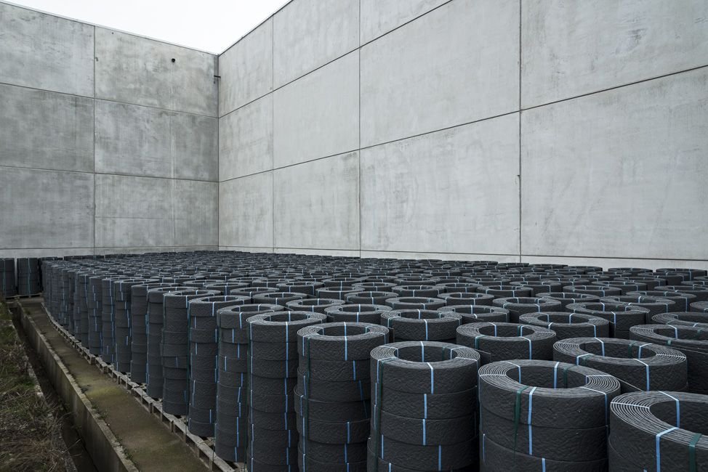

Slide 51
Richard John Seymour
From the series “Yiwu Commodity City”
Yiwu is a city in the Zhejiang province of China, South of Shanghai. It hosts China Commodities City, famous for being the largest small commodity wholesale market in the world.
Thousands of stalls like this exhibit multiple and slight variations on a particular item. Each individual seller occupies a space consumed by the very items that make them their living. They sell orders by the thousand to be exported across complex logistics networks, disseminated to a world of dispersed consumers.
This collection represents about 10% of this series, and less than 0.1% of Yiwu's stalls. These images become analogous to the relentless production of the consumer items themselves, and extend the idea of the 'photo project' beyond a collection of individual images and into a conceptual artwork in it's entirety, raising questions about the nature of value, economies of scale, and human labour.

Slide 52
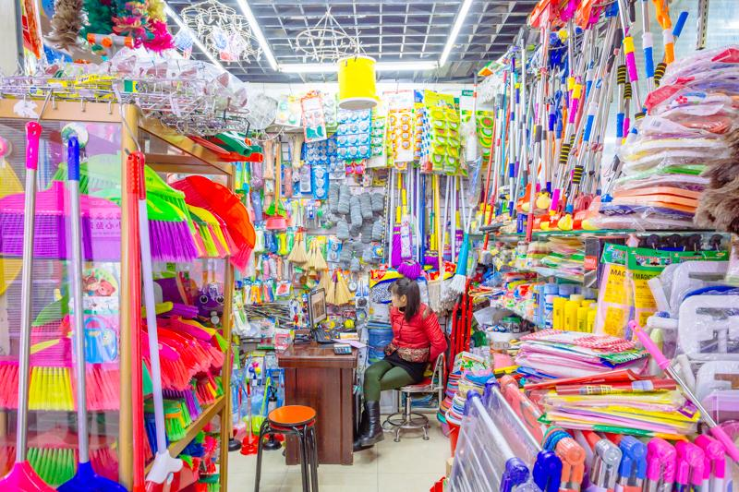

Slide 53
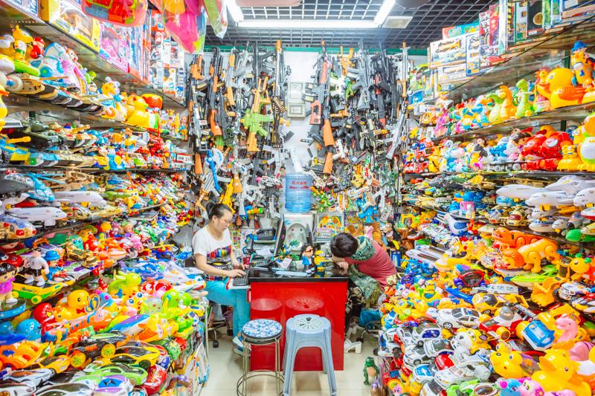

Slide 54
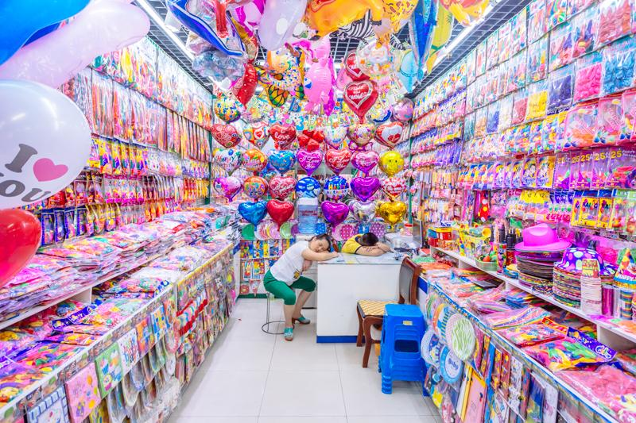

Slide 55
Von Wong
Benjamin Von Wong (born November 14, 1986) is a Canadian artist, activist, and photographer best known for his environmental art installations and hyper-realist art style. He is a motivational speaker and an advocate against Ocean Plastics He is also notable for creating several viral Social Media campaigns,

Slide 56
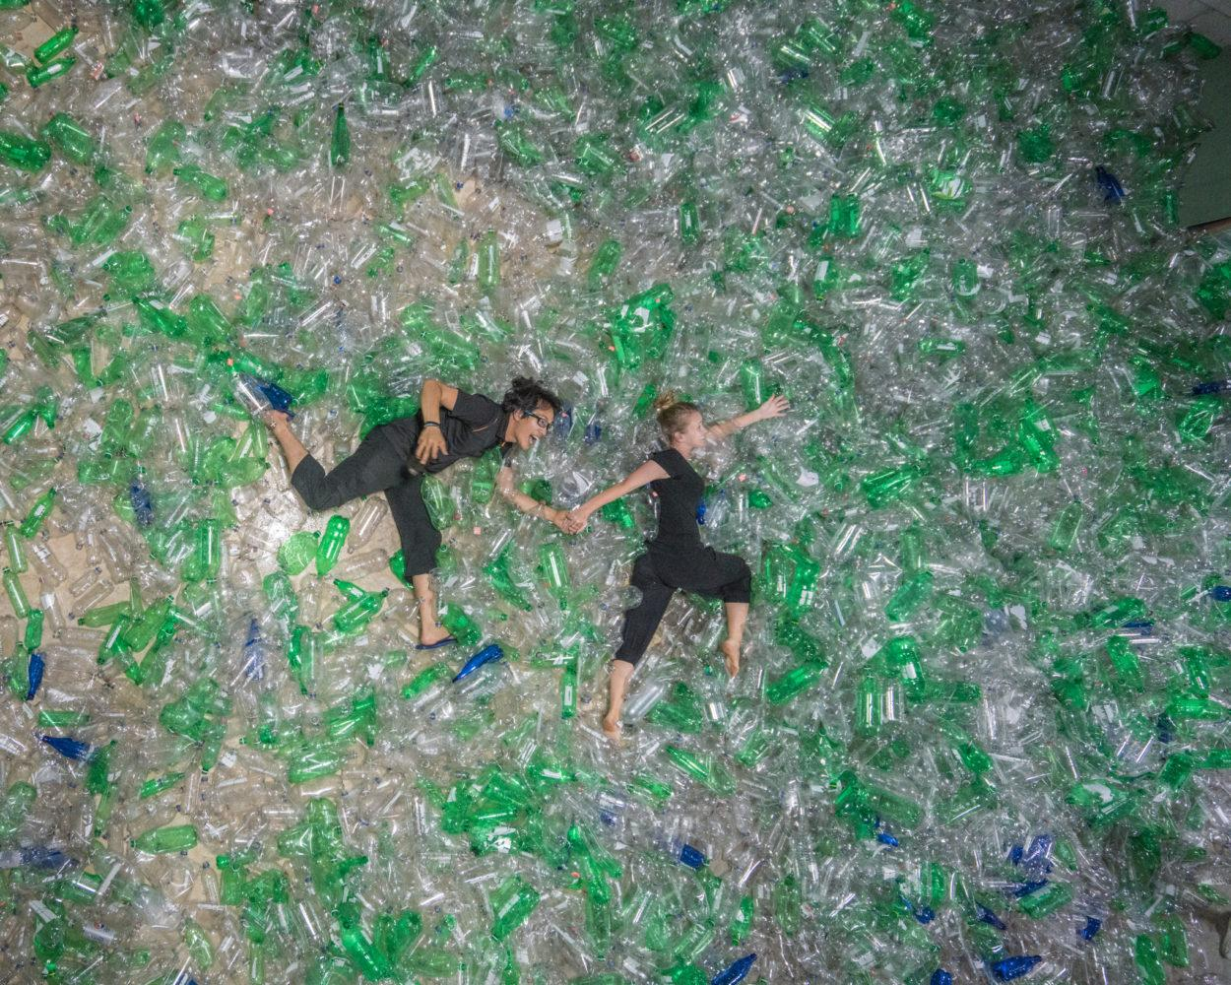

Slide 58
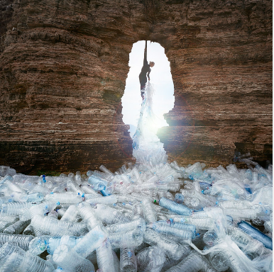

Slide 59
Maria Sarbova
From her series “Plastic World”
In Plastic World, Mária Švarbová's subjects act as emotionless mannequins. Through blank stares, stiff poses and total absence of emotion, the series challenges the viewer to question the ingrained roles people play in society.
Every image flows into another scene forming the overall narrative of the series -- the emptiness and mindless inability to change one's predetermined role in life in the the absence of emotion. Complex and dreamy, Plastic World presents an imaginary world (inspired by historic artifacts and environments of Communist Czechoslovakia).

Slide 60
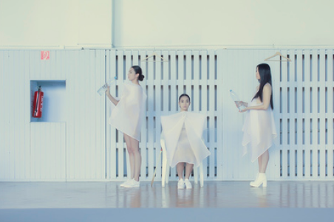

Slide 61
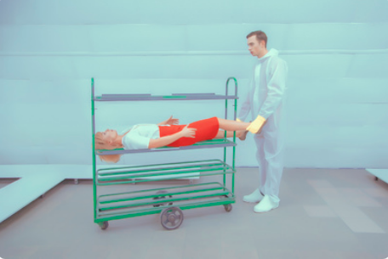

Slide 62
